Slide 1

Summary Statistics
Andreea Toca

Slide 2



Overview
Data
Informal Data Analysis
Formal Analysis
Categorical data
Factor
Numerical data
Discrete
Continuous
Histogram
Boxplot
Scatterplot
Q-Q plot
Normality assumption
Statistical tests
T-test
Correlation
Chi-squared test
Linear model
Anova
Ancova
Logistic model

Slide 3
Data
Categorical
Discrete
Continuous
Data that can be divided into groups/categories:
Gender (male, female)
Level of education (BSc, MSc, PhD, …)
Factor:
“female” “male”
1 ,2, 3 as.factor()
factor()
Based on counts:
Number of students (56, 49) -> fixed number that does not make sense to be 56,5
Unfixed number of possible measurements:
Weight (30 kg, 85.2 kg)
Speed (100.2, 52.41 …)
Temperature (21, 5, -68)

Slide 4
How to determine what data you have
class(one_variable)
is.numeric(one_variable)
> class(Computers)
[1] "data.frame"
> class(Computers$price)
[1] "numeric"
> class(Computers$cd)
[1] "factor"
> is.numeric(Computers$price)
[1] TRUE
> is.numeric(Computers$cd)
[1] FALSE
*For logical data:
comparison operators <, <=, ==, !=, >=, > to produce logical values
to combine values ! (not), & (and), | (or)
> "one" == 1 [1] FALSE
> x <- c(1, 2, 3, 4, 5, 6, 7, 8, 9)
> x > 5
[1] FALSE FALSE FALSE FALSE FALSE TRUE TRUE TRUE TRUE
> x < 2 | x > 7
[1] TRUE FALSE FALSE FALSE FALSE FALSE FALSE TRUE TRUE
> x > 2 & x < 7
[1] FALSE FALSE TRUE TRUE TRUE TRUE FALSE FALSE FALSE
> which(x > 2 & x < 7) # prints indices
[1] 3 4 5 6
str(data_set)
> str(Computers)
'data.frame': 6259 obs. of 10 variables:
$ price : num 1499 1795 1595 1849 3295 ...
$ speed : num 25 33 25 25 33 66 25 50 50 50 ...
$ hd : num 80 85 170 170 340 340 170 85 210 210 ...
$ ram : num 4 2 4 8 16 16 4 2 8 4 ...
$ screen : num 14 14 15 14 14 14 14 14 14 15 ...
$ cd : Factor w/ 2 levels "no","yes": 1 1 1 1 1 1 2 1 1 1 ...
$ multi : Factor w/ 2 levels "no","yes": 1 1 1 1 1 1 1 1 1 1 ...
$ premium: Factor w/ 2 levels "no","yes": 2 2 2 1 2 2 2 2 2 2 ...
$ ads : num 94 94 94 94 94 94 94 94 94 94 ...
$ trend : num 1 1 1 1 1 1 1 1 1 1 ...
For more, check CHAPTER 2!

Slide 5
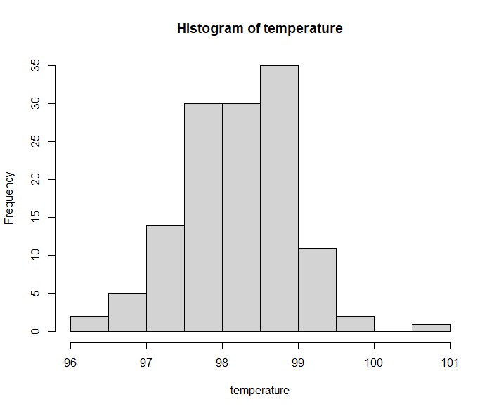
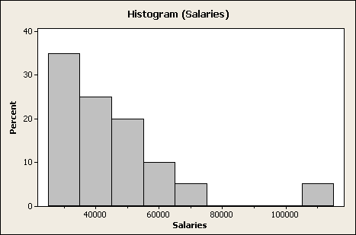
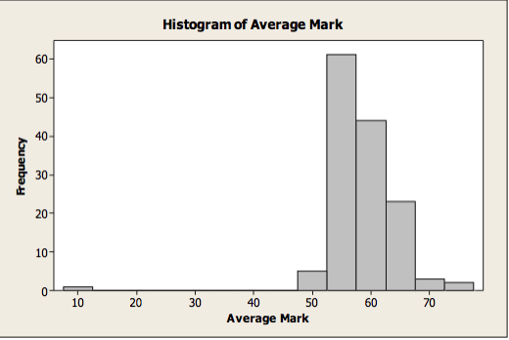
Informal Data Analysis
Histogram
Divides the interval that covers the whole data set in subintervals and counts how many points fall inside that interval -> the bar plotted represents the counts => groups individual data points
Data: continuous
R code:
> with(normtemp, hist(temperature))
Normal
Right-skewed
Left-skewed

Slide 6
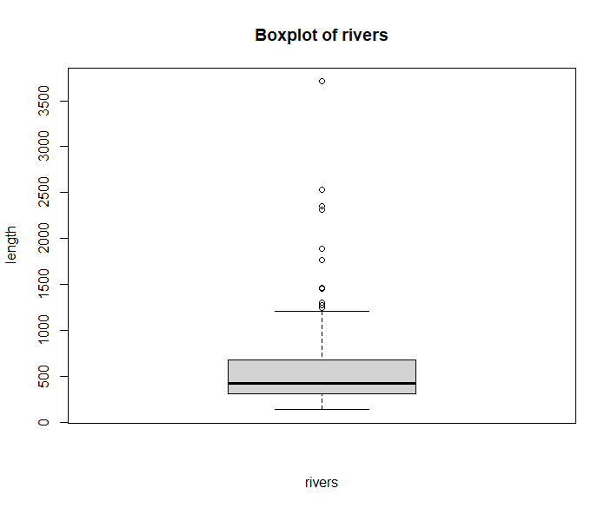
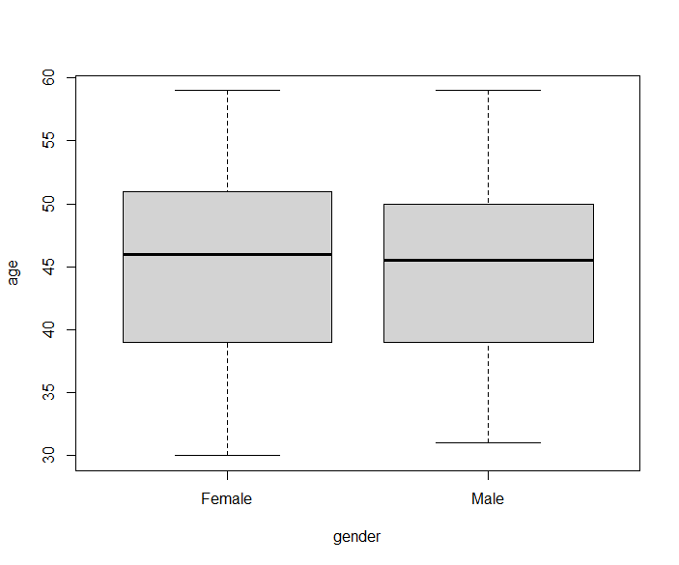
Informal Data Analysis
Boxplot
Minimum, maximum, median, 25% quartile, 75% quartile, outliers
Data: continuous
R code:
> boxplot(rivers, xlab="rivers", ylab="length")
> with(tastesgreat, boxplot(age ~ gender))
Right skewed
Normal

Slide 7
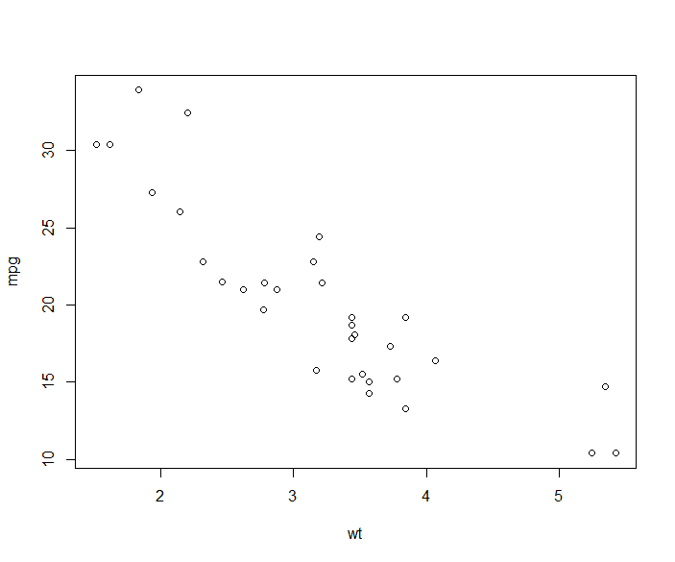
Informal Data Analysis
Scatterplot
Look for relationships in the data, mostly used in lm
Data: continuous
R code:
> with(mtcars, plot(wt, mpg))
Weight vs Miles/gallon
Weight vs Miles/gallon
Weight vs Miles/gallon
Negative relationship
No relationship (effect)
Positive relationship

Slide 8
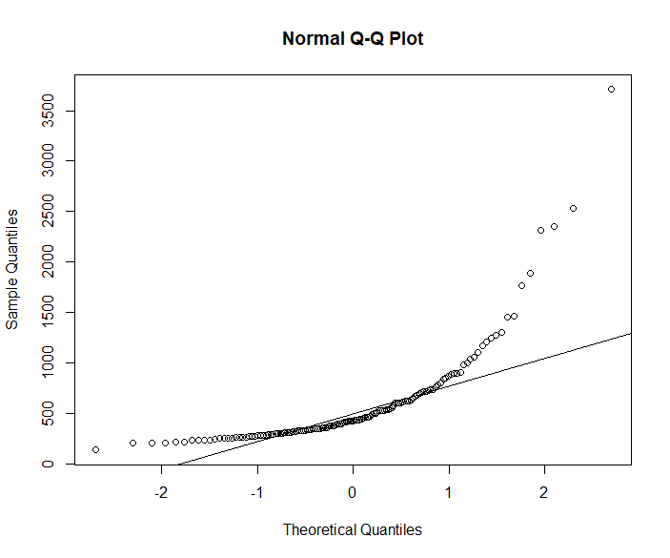
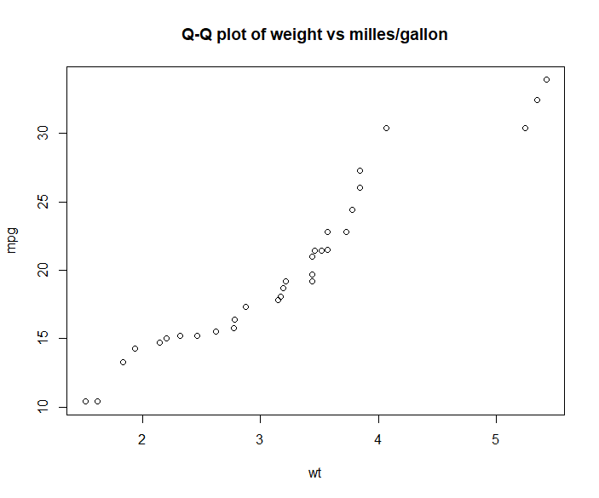
Informal Data Analysis
Q-Q plot
Plots of two quantiles against each other
Data: continuous
Normal Q-Q plot - data are plotted against the theoretical distribution
Q-Q plot – plots two distributions against each other
R code:
> qqnorm(rivers)
> qqline(rivers)
> with(mtcars, qqplot(wt, mpg))

Slide 9
Informal Data Analysis
Summary statistics
Positive skew: median < mean
Negative skew: mean < median
R code:
> mean(sample_data$variable)
> aggregate(some_variable ~ type, data = sample_data, mean)
> aggregate(some_variable ~ type, data = sample_data, sd) -> good for equal variance assumption
> tapply(some_variable, type, mean)

Slide 10
Informal Data Analysis
Frequency table
Data: categorical, discrete (if it has a fix number of options)
Two way
If you already have the counts, you can use rbind() or cbind()
If you think it is more useful to see the counts based on the vector index, use tabulate()
Be careful at overinterpreting
> with(Computers, table(speed, ram))
ram
speed 2 4 8 16 24 32
25 73 320 100 73 0 0
33 153 951 586 251 92 0
50 73 383 360 129 49 0
66 73 492 983 390 84 6
75 11 13 54 20 16 8
100 11 77 237 133 56 2
4 6 8
US 33 13 12
Europe 7 7 0
Asia 7 10 1
> n = 100
> dice = sample(1:6,n,replace=T)
> tabulate(dice)
[1] 23 7 18 12 11 29

Slide 11
Normality Assumption
Tests:
Shapiro-Wilk Test
H0 : data are normally distributed
Decision: p-value = 0.232 > 0.05, we can not reject the null hypothesis that the data is normally distributed
Conclusion: the data provide no evidence against normality
> shapiro.test(normtemp$temperature)
Shapiro-Wilk normality test
data: normtemp$temperature
W = 0.98658, p-value = 0.2332

Slide 12
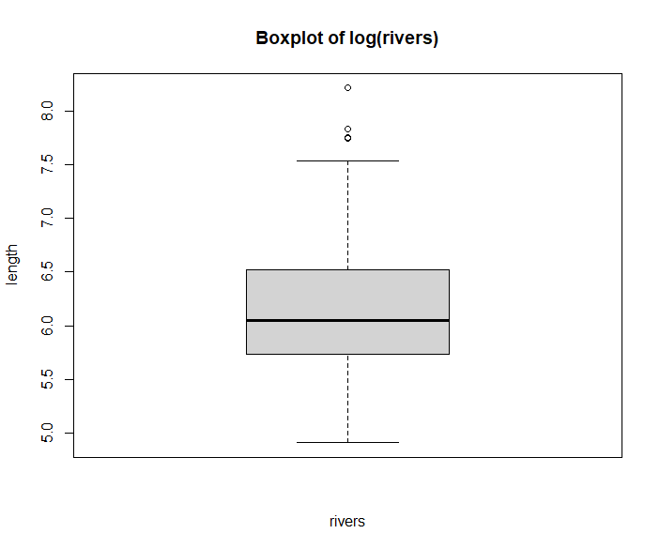

Normality Assumption
Data do not look normal?
Try:
square-root for moderate skew
log for greater skew and positive data
Note: transform the data back when interpreting
$sqrt(data)→result ⇒ {result}^{2}$
$\log\left(data\right) →result ⇒{ e}^{result}$
Still not satisfied?
Use bootstrap to construct a hypothesis test
Use non-parametric tests

Slide 13
Formal Data Analysis - parametric
One sample t-test
Assumptions:
Number of groups = 1
Normal distribution – histogram/boxplot
Large dataset
Data: continuous
*t-test is robust to deviations from normality
RQ:
Is the mean = to x?
Is there evidence that the mean price of Computers is greater than 50?
H0: the true mean = x
HA: the true mean ≠ x
R code:
Decision: p-value < 2.2e-16 < 0.05, we reject the null hypothesis
Conclusion: the data don’t provide enough evidence that the mean price of the computers is 50
> t.test(Computers$price, mu=50)
One Sample t-test
data: Computers$price
t = 295.53, df = 6258, p-value < 2.2e-16
alternative hypothesis: true mean is not equal to 50
95 percent confidence interval:
2205.185 2233.968
sample estimates:
mean of x
2219.577

Slide 14
Formal Data Analysis – parametric
Two sample t-test
Assumptions
Number of groups = 2
Groups are independent
Normal distribution – boxplot
Large dataset
Equal variance: sd approximately equal*
Data: continuous
RQ:
Is there a significant difference in Z between X & Y?
Is there a significant difference in price between Computers premium and non-premium?
H0: mean1 = mean2
HA: mean1 ≠ mean2
R code:
Decision: p-value = 0.1223 > 0.05, we do not reject the null hypothesis of equal means
Conclusion: Data do not provide sufficient evidence for a difference in price due to multimedia
> yes <- Computers$price[Computers$multi == "yes"]
> no <- Computers$price[Computers$multi == "no"]
> t.test(yes, no)
Welch Two Sample t-test
data: yes and no
t = -1.5463, df = 1356.5, p-value = 0.1223
alternative hypothesis: true difference in means is not equal to 0
95 percent confidence interval:
-63.324997 7.498555
sample estimates:
mean of x mean of y
2195.557 2223.470
The course did not stress too much this assumption
When you look at the boxplots, check to see if the boxes are similar for the two groups
Calculate sd for each groups and see if they are similar, they don’t have to be exactly the same for the assumption to hold

Slide 15
Formal Data Analysis – non-parametric
Wilcoxon Rank-Sum
Assumptions
Number of groups = 2
Groups are independent
Data: continuous
RQ:
Is there a significant difference in Z between X & Y?
Is there a significant difference in price between Computers with multimedia and without multimedia?
H0: mean1 = mean2
HA: mean1 ≠ mean2
R code:
Decision: p-value = 0.7854 > 0.05, we do not reject the null hypothesis of equal means
Conclusion: Data do not provide sufficient evidence for a difference in price due to multimedia
> wilcox.test(yes, no)
Wilcoxon rank sum test with continuity correction
data: yes and no
W = 2337501, p-value = 0.7854
alternative hypothesis: true location shift is not equal to 0

Slide 16
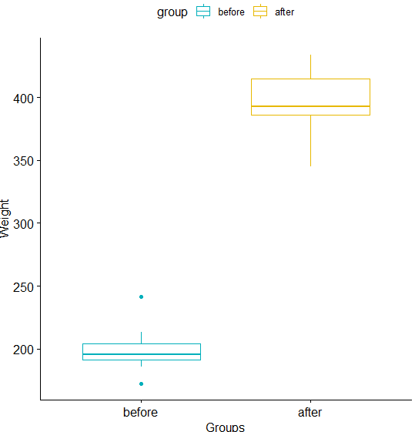
Formal Data Analysis - parametric
Paired t-test
Assumptions:
Number of groups = 2 from 1 sample
Groups are dependent
The mean is taken for the same variable
Most common and effective type of pairing is self-pairing, a single subject being evaluated in two different conditions
Normal distribution / large dataset
Equal variance (see slide 14)
Data : numerical
length(group1) = length(group2)
RQ:
Is there a significant difference in X at A and B?
Is there a significant difference in weight of mice before the treatment and after the treatment?
H0: mean1 = mean2
HA: mean1 ≠ mean2
R code:
> t.test(weight ~ groups, paired = TRUE)
> t.test(condition1, contition2, paired = TRUE)

Slide 17
Formal Data Analysis – non-parametric
Wilcoxon Signed-Rank
Assumptions
Number of groups = 2 from 1 sample
Groups are dependent (paired)
Data: numerical
length(group1) = length(group2)
RQ:
Is there a significant difference in X at A and B?
H0: mean1 = mean2
HA: mean1 ≠ mean2
R code:
> wilcox.test(condition1, condition2, paired = TRUE)

Slide 18
Formal Data Analysis –parametric
Pearson’s correlation coefficient
Assumptions
Number of groups = 2
Groups are dependent (paired)
Absence of outliers
Data: continuous
RQ:
Are A and B correlated?
H0: A and B are independent
HA: A and B are dependent
R code:
Decision: p-value < 2.2e-16 < 0.05, we reject the null hypothesis of independence
Conclusion: There is sufficient evidence for positive correlation between BMI and blood pressure. The correlation coefficient of 0.727 shows strong dependency.
> with(fat, cor.test(body.fat,BMI, method = "pearson"))
Pearson's product-moment correlation
data: body.fat and BMI
t = 16.789, df = 250, p-value < 2.2e-16
alternative hypothesis: true correlation is not equal to 0
95 percent confidence interval:
0.6641703 0.7812826
sample estimates:
cor
0.7279942

Slide 19
Formal Data Analysis – non-parametric
Chi-squared goodness of fit
Assumptions
Number of groups = 1
At least 5 observations in each level
Data: categorical
RQ:
Does the data match the given frequency?
Is the data consistent with a specified distribution?
H0: the data matche the given freq.
HA: the data don’t match the given freq.
R code:
Decision: the p-value is 8.803e-07 which is < 0.05, we reject the null hypothesis
Conclusion: the colors are significantly not commonly distributed.
> tulip <- c(81, 50, 27)
> res <- chisq.test(tulip, p = c(1/3, 1/3, 1/3))
> res
Chi-squared test for given probabilities
data: tulip
X-squared = 27.886, df = 2, p-value = 8.803e-07

Slide 20
Formal Data Analysis – non-parametric
Chi-squared test for independence
Assumptions
Number of groups = 2
Groups are independent
At least 5 observations in each level
Frequency table
Data: categorical
RQ:
Are A and B independent of each other?
H0: A and B are independent
HA: A and B are dependent
Decision: Reject null hypothesis of independence lesions and locations
Conclusion: There is dependence in the data
R code:
> oral.lesion
Kerala Gujarat Andhra
Labial.Mucosa 0 1 0
Buccal.Mucosa 8 1 8
Commissure 0 1 0
Gingiva 0 1 0
Hard.Palate 0 1 0
Soft.Palate 0 1 0
Tongue 0 1 0
Floor.Mouth 1 0 1
Alveolar.Ridge 1 0 1
> chisq.test(x=oral.lesion)
Pearson's Chi-squared test
data: oral.lesion
X-squared = 22.099, df = 16, p-value = 0.14
Warning message:
In chisq.test(x = oral.lesion) : Chi-squared approximation may be incorrect
> chisq.test(x=oral.lesion, simulate.p.value = TRUE)
Pearson's Chi-squared test with simulated p-value (based on 2000 replicates)
data: oral.lesion
X-squared = 22.099, df = NA, p-value = 0.03248

Slide 21
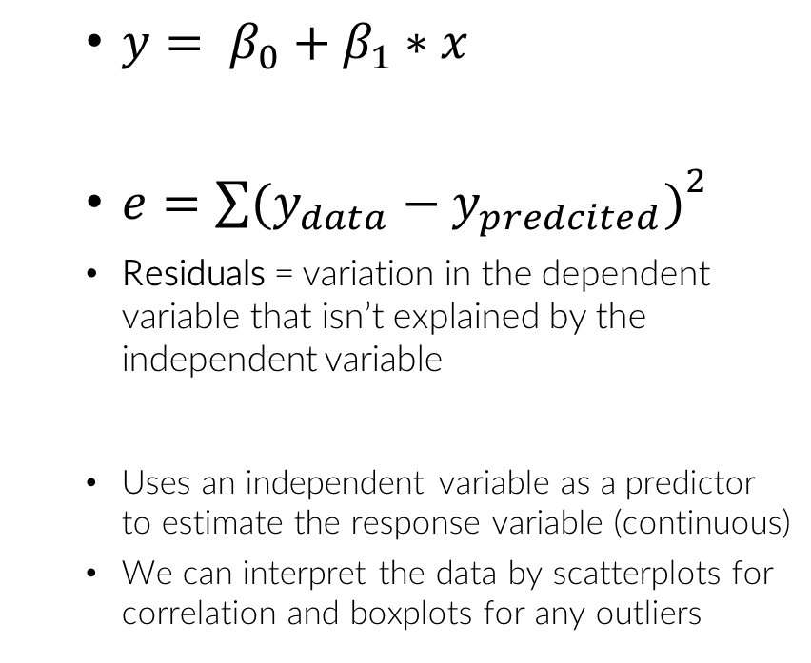
Formal Data Analysis
Simple linear regression
Assumptions
Residuals have a constant variance
Residuals are approx. normally distributed
Residuals are independent
Linear relationship of data - scatterplot
Data: continuous
RQ:
Are X and Y linearly dependent?
Is there a significant effect of X on Y?
H0: Y is not linearly dependent on variable X
HA: Y is linearly dependent on variable X
$y= β_{0}+β_{1}∗x$
$e={\sum{(y_{data}−y_{predcited})}}^{2}$
Residuals = variation in the dependent variable that isn’t explained by the independent variable
Uses an independent variable as a predictor to estimate the response variable (continuous)
We can interpret the data by scatterplots for correlation and boxplots for any outliers
intercept
coefficient

Slide 22
Formal Data Analysis
> data(alaska.pipeline)
> res = lm(lab.defect ~ field.defect, alaska.pipeline)
> plot(res)
> res.log = lm(log(lab.defect) ~ log(field.defect), alaska.pipeline)
> par(mfrow=c(2,2)) # set the plot panel to 2x2
> plot(res.log)
> par(mfrow=c(1,1)) # set the plot panel back to 1
observe increasing variance with increasing fitted values (residuals vs fitted)
this is against the assumption of constant variance in the linear model
log transform nicely solves the problem
* For all tests that are performed through lm look for the residuals plot and assess the variance, normality, outliers

Slide 23
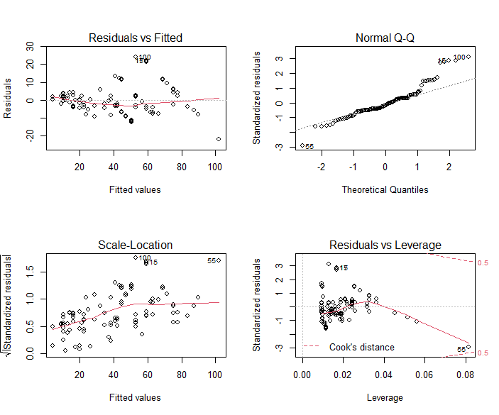
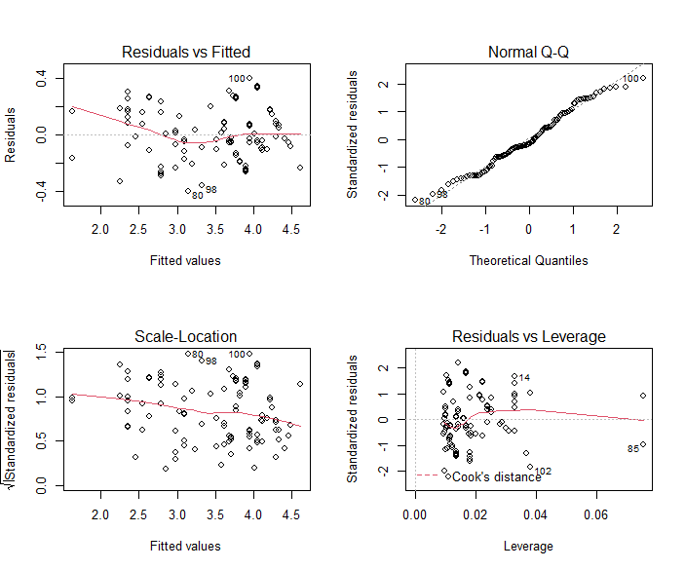
Formal Data Analysis
plot(res)
plot(res.log)

Slide 24
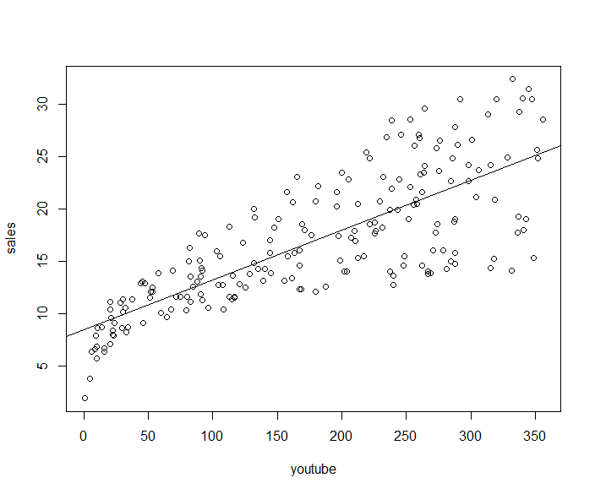
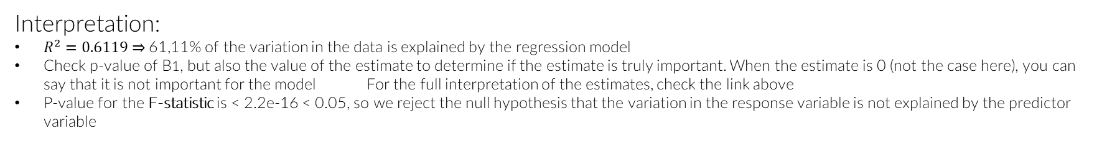
Formal Data Analysis
It contains the impact of three advertising medias (youtube, facebook and newspaper) on sales. Data are the advertising budget in thousands of dollars along with the sales ( http://www.sthda.com/english/articles/40-regression-analysis/167-simple-linear-regression-in-r/ )
> with(marketing, plot(sales~youtube))
> model <- lm(sales ~ youtube, data = marketing)
> summary(model)
Call:
lm(formula = sales ~ youtube, data = marketing)
Residuals:
Min 1Q Median 3Q Max
-10.0632 -2.3454 -0.2295 2.4805 8.6548
Coefficients:
Estimate Std. Error t value Pr(>|t|)
(Intercept) 8.439112 0.549412 15.36 <2e-16 ***
youtube 0.047537 0.002691 17.67 <2e-16 ***
---
Signif. codes: 0 ‘***’ 0.001 ‘**’ 0.01 ‘*’ 0.05 ‘.’ 0.1 ‘ ’ 1
Residual standard error: 3.91 on 198 degrees of freedom
Multiple R-squared: 0.6119, Adjusted R-squared: 0.6099
F-statistic: 312.1 on 1 and 198 DF, p-value: < 2.2e-16
H0
B0 = 0
B1 = 0
H0: B1 = 0
HA: B1 ≠ 0
Interpretation:
$R^{2}=0.6119⇒$61,11% of the variation in the data is explained by the regression model
Check p-value of B1, but also the value of the estimate to determine if the estimate is truly important. When the estimate is 0 (not the case here), you can say that it is not important for the model For the full interpretation of the estimates, check the link above
P-value for the F-statistic is < 2.2e-16 < 0.05, so we reject the null hypothesis that the variation in the response variable is not explained by the predictor variable

Slide 25


Formal Data Analysis
Multiple linear regression
Assumptions
Number of groups = 3+
Groups are independent
Residuals have a constant variance
Residuals are approx. normally distributed
Residuals are independent
Absence of outliers in the data - boxplot
Data: continuous
RQ:
Is there a significant effect of X1, X2, … on Y?
H0: there is no significant effect of X1, X2, … on Y
Interpretation:
All mediums are significant, except the newspaper
Adjusted $R^{2}$ - 89,5% of the variation in the data is explained by the model
For the full interpretation of the coefficients: http://www.sthda.com/english/articles/40-regression-analysis/168-multiple-linear-regression-in-r/
$y= β_{0}+β_{1}∗x_{1}+β_{2}∗x_{2}+…$
lm(y ~ x1 + x2 + …, data)
Marginal test: Applies every time you use lm
> model <- lm(sales ~ youtube + facebook + newspaper, data = marketing)
> summary(model)
Call:
lm(formula = sales ~ youtube + facebook + newspaper, data = marketing)
Residuals:
Min 1Q Median 3Q Max
-10.5932 -1.0690 0.2902 1.4272 3.3951
Coefficients:
Estimate Std. Error t value Pr(>|t|)
(Intercept) 3.526667 0.374290 9.422 <2e-16 ***
youtube 0.045765 0.001395 32.809 <2e-16 ***
facebook 0.188530 0.008611 21.893 <2e-16 ***
newspaper -0.001037 0.005871 -0.177 0.86
---
Signif. codes: 0 ‘***’ 0.001 ‘**’ 0.01 ‘*’ 0.05 ‘.’ 0.1 ‘ ’ 1
Residual standard error: 2.023 on 196 degrees of freedom
Multiple R-squared: 0.8972, Adjusted R-squared: 0.8956
F-statistic: 570.3 on 3 and 196 DF, p-value: < 2.2e-16
H0
B0 = 0
B1 = 0
B2 = 0
B3 = 0
H0: B1 = B2 = B3 = 0
HA: Bi ≠ 0

Slide 26
Formal Data Analysis – parametric
One-way ANOVA
Assumptions
Number of groups = 3+
Groups are independent
Normal distribution – boxplot
Equal variance (see slide 14)
Data: 1 numerical + 1 categorical (predictor)
*anova is robust to deviations from normality
RQ:
Is there a significant difference between the 3 treatments?
Does X-num significantly differ by Y-cat?
H0: mean1 = mean2 = mean3
HA: mean1 ≠ mean2 (or any other combination)
R code:
oneway.test() returns a p-value indicating the probability that the null hypothesis is true given the data
summary(aov()) returns an ANOVA table with the effects of the various variables, and p-values
summary(lm()) returns an ANOVA table with the effects of the various variables and the intercept, and p-values

Slide 27
Formal Data Analysis
> summary(aov(Speed ~ factor(Expt),data = morley))
Df Sum Sq Mean Sq F value Pr(>F)
factor(Expt) 4 94514 23629 4.288 0.00311 **
Residuals 95 523510 5511
---
Signif. codes: 0 ‘***’ 0.001 ‘**’ 0.01 ‘*’ 0.05 ‘.’ 0.1 ‘ ’ 1
> summary(lm(Speed ~ factor(Expt),data = morley))
Call:
lm(formula = Speed ~ factor(Expt), data = morley)
Residuals:
Min 1Q Median 3Q Max
-259.00 -42.62 2.25 41.75 161.00
Coefficients:
Estimate Std. Error t value Pr(>|t|)
(Intercept) 909.00 16.60 54.762 < 2e-16 ***
factor(Expt)2 -53.00 23.47 -2.258 0.026251 *
factor(Expt)3 -64.00 23.47 -2.726 0.007627 **
factor(Expt)4 -88.50 23.47 -3.770 0.000283 ***
factor(Expt)5 -77.50 23.47 -3.301 0.001356 **
---
Signif. codes: 0 ‘***’ 0.001 ‘**’ 0.01 ‘*’ 0.05 ‘.’ 0.1 ‘ ’ 1
Residual standard error: 74.23 on 95 degrees of freedom
Multiple R-squared: 0.1529, Adjusted R-squared: 0.1173
F-statistic: 4.288 on 4 and 95 DF, p-value: 0.003114
H0
> oneway.test(Speed ~ factor(Expt), data = morley)
One-way analysis of means (not assuming equal variances)
data: Speed and factor(Expt)
F = 3.0061, num df = 4.000, denom df = 47.044, p-value = 0.02738
B0 = 0
B1 = 0
B2 = 0
B3 = 0
B4 = 0
Results are slightly different due to the way they are
calculated
If one of the tests rejects the null hypothesis, the same
will do the other two
If you want to check for equal variance: aggregate(response ~ type, data = dataset, sd) and see if sd is similar,
if it is, set var.equal=TRUE to oneway.test
mean(factor(Expt)1)
mean(factor1) - mean(factor2) = 0
mean(factor(Expt)1) – mean(factor(Expt)2)

Slide 28
Formal Data Analysis – non-parametric
Kruskal-Wallis Test
Assumptions
Number of groups = 3+
Groups are independent
Data: 1 numerical + 1 categorical
RQ:
Is there a significant difference between the 3 treatments?
Does X-num significantly differ by Y-cat?
H0: mean1 = mean2 = mean3
HA: mean1 ≠ mean2 ≠ mean3
R code:
> kruskal.test(response ~ group, data)

Slide 29
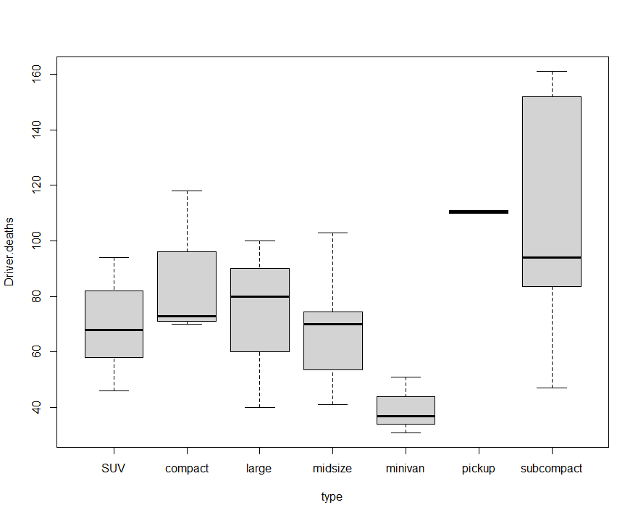
Formal Data Analysis
Almost all distributions are off
> with(carsafety, boxplot(Driver.deaths ~ type))
> aggregate(Driver.deaths ~ type, data = carsafety, mean)
type Driver.deaths
1 SUV 69.71429
2 compact 83.50000
3 large 73.33333
4 midsize 67.14286
5 minivan 39.66667
6 pickup 110.50000
7 subcompact 110.42857
> aggregate(Driver.deaths ~ type, data = carsafety, sd)
type Driver.deaths # observe differences in sd
1 SUV 17.4233013
2 compact 23.0578981
3 large 30.5505046
4 midsize 20.3423087
5 minivan 10.2632029
6 pickup 0.7071068
7 subcompact 44.4029171
> oneway.test(Driver.deaths ~ type, carsafety) # not appropriate given the data
One-way analysis of means (not assuming equal variances)
data: Driver.deaths and type
F = 26.465, num df = 6.0000, denom df = 8.7853, p-value = 3.75e-05
> kruskal.test(Driver.deaths ~ type, carsafety)
Kruskal-Wallis rank sum test
data: Driver.deaths by type
Kruskal-Wallis chi-squared = 14.141, df = 6, p-value = 0.0281
Based on oneway.test and Kruskal, reject the null hypothesis, but anova is not reliable in this case
Decision: Reject H0 of equal means
Conclusion: Data provide evidence for different effects of types of cars

Slide 30
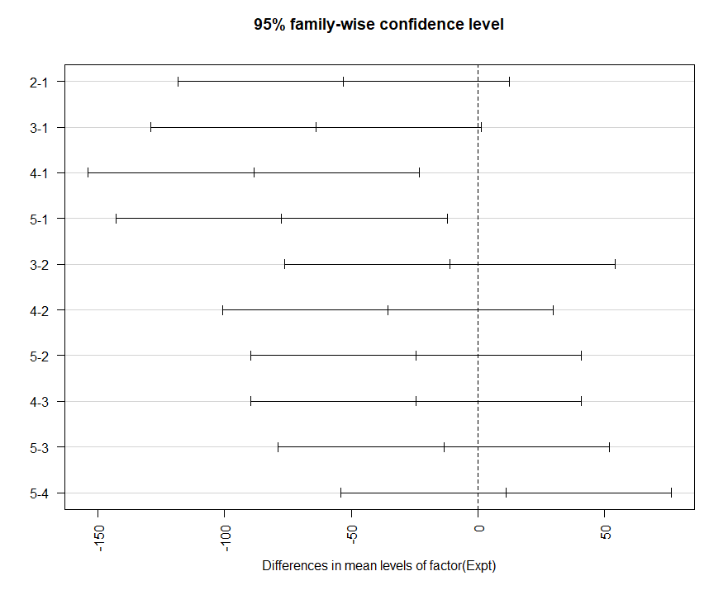
Formal Data Analysis
Tukey’s HSD (only after the formal analysis)
Pairwise comparison of difference of means
R code:
> aov.model(Speed ~ factor(Expt),data = morley)
> TukeyHSD(aov.model)
Tukey multiple comparisons of means
95% family-wise confidence level
Fit: aov(formula = Speed ~ factor(Expt), data = morley)
$`factor(Expt)`
diff lwr upr p adj
2-1 -53.0 -118.28006 12.280058 0.1679880
3-1 -64.0 -129.28006 1.280058 0.0574625
4-1 -88.5 -153.78006 -23.219942 0.0025733
5-1 -77.5 -142.78006 -12.219942 0.0115793
3-2 -11.0 -76.28006 54.280058 0.9899661
4-2 -35.5 -100.78006 29.780058 0.5571665
5-2 -24.5 -89.78006 40.780058 0.8343360
4-3 -24.5 -89.78006 40.780058 0.8343360
5-3 -13.5 -78.78006 51.780058 0.9784065
5-4 11.0 -54.28006 76.280058 0.9899661
> plot(TukeyHSD(aov.model), las=2)
Also in lm
green = significant
All four marginal t-test (from lm) differences are significant, which is not inline with Tukey HSD
Difference is significant is p-value < 0.05, and CI does not include 0

Slide 31
Formal Data Analysis
ANCOVA
ANCOVA tests whether the independent variable still influences the dependent variable after the influence of the covariate(s) has been removed
Assumptions
Number of groups = 2+
Groups are independent
Normality in the outcome variable
Beware of outliers
The two numerical variables are linearly related
Data: 1 numerical +
1+ categorical & 1 numerical (predictors)
RQ: there is no significant effect of the categorical variable and the numerical variable (response) controlling for numerical variable (covariate)
H0: mean1 = mean2 = …
Mean temperature for female = mean temperature for male
HA: mean1 ≠ mean2 (or any other combination)
R code:
> summary(lin.mod <- lm(temperature ~ hr + factor(gender), normtemp))
Call:
lm(formula = temperature ~ hr + factor(gender), data = normtemp)
Residuals:
Min 1Q Median 3Q Max
-1.86363 -0.45624 0.01841 0.47366 2.33424
Coefficients:
Estimate Std. Error t value Pr(>|t|)
(Intercept) 96.250814 0.648717 148.371 < 2e-16 ***
hr 0.025267 0.008762 2.884 0.00462 **
factor(gender)2 0.269406 0.123277 2.185 0.03070 *
---
Signif. codes: 0 ‘***’ 0.001 ‘**’ 0.01 ‘*’ 0.05 ‘.’ 0.1 ‘ ’ 1
Residual standard error: 0.7017 on 127 degrees of freedom
Multiple R-squared: 0.09825, Adjusted R-squared: 0.08405
F-statistic: 6.919 on 2 and 127 DF, p-value: 0.001406
After correction for Heart Rate, Females have larger temperature of 0.27 degrees Fahrenheit

Slide 32
Formal Data Analysis
> anova.mod1 <- aov(len ~ factor(supp) + factor(dose), data = ToothGrowth)
> summary(anova.mod1)
Df Sum Sq Mean Sq F value Pr(>F)
factor(supp) 1 205.4 205.4 14.02 0.000429 ***
factor(dose) 2 2426.4 1213.2 82.81 < 2e-16 ***
Residuals 56 820.4 14.7
---
Signif. codes: 0 ‘***’ 0.001 ‘**’ 0.01 ‘*’ 0.05 ‘.’ 0.1 ‘ ’ 1
> anova.mod2 <- aov(len ~ factor(supp) * factor(dose), data = ToothGrowth)
> summary(anova.mod2)
Df Sum Sq Mean Sq F value Pr(>F)
factor(supp) 1 205.4 205.4 15.572 0.000231 ***
factor(dose) 2 2426.4 1213.2 92.000 < 2e-16 ***
factor(supp):factor(dose) 2 108.3 54.2 4.107 0.021860 *
Residuals 54 712.1 13.2
---
Signif. codes: 0 ‘***’ 0.001 ‘**’ 0.01 ‘*’ 0.05 ‘.’ 0.1 ‘ ’ 1
Two-way ANOVA
Assumptions
Groups: each variable should have 2+ samples
Groups are independent
Equal variance (see slide 14)
Data: 1 numerical + 2 categorical (predictors)
RQ: Is tooth length affected be the dose level of vitamin C (dose) and is that depend on the delivery method (supp) ?
Main effects for supplement and dose are significant
Interaction between supplement and dose significant
Interaction term
From the ANOVA table we can conclude that both supp and dose are statistically significant; dose is the most significant factor variable. (2026.4) -> changing delivery methods (supp) or the dose of vitamin C, will impact significantly the mean tooth length.
Explanation from : http://www.sthda.com/english/wiki/two-way-anova-test-in-r

Slide 33
Formal Data Analysis
> summary(lin.mod2 <- lm(len ~ factor(supp) * factor(dose), data = ToothGrowth))
Call:
lm(formula = len ~ factor(supp) * factor(dose), data = ToothGrowth)
Residuals:
Min 1Q Median 3Q Max
-8.20 -2.72 -0.27 2.65 8.27
Coefficients:
Estimate Std. Error t value Pr(>|t|)
(Intercept) = referecnce level* 13.230 1.148 11.521 3.60e-16 ***
factor(supp)VC -5.250 1.624 -3.233 0.00209 **
factor(dose)1 9.470 1.624 5.831 3.18e-07 ***
factor(dose)2 12.830 1.624 7.900 1.43e-10 ***
factor(supp)VC:factor(dose)1 -0.680 2.297 -0.296 0.76831
factor(supp)VC:factor(dose)2 5.330 2.297 2.321 0.02411 *
---
Signif. codes: 0 ‘***’ 0.001 ‘**’ 0.01 ‘*’ 0.05 ‘.’ 0.1 ‘ ’ 1
Residual standard error: 3.631 on 54 degrees of freedom
Multiple R-squared: 0.7937, Adjusted R-squared: 0.7746
F-statistic: 41.56 on 5 and 54 DF, p-value: < 2.2e-16
To look for effects:
Main effect = e.g. Difference in the predicted mean response from changing dose 0.5 to dose 1 assuming the first factor doesn’t change
There is a decreasing effect of VC, an increasing effect of Dose and increasing interaction effect between VC and Dose 2
* factor(supp)OJ
Estimate: mean(factor(supp) OJ[dose=0.5])

Slide 34
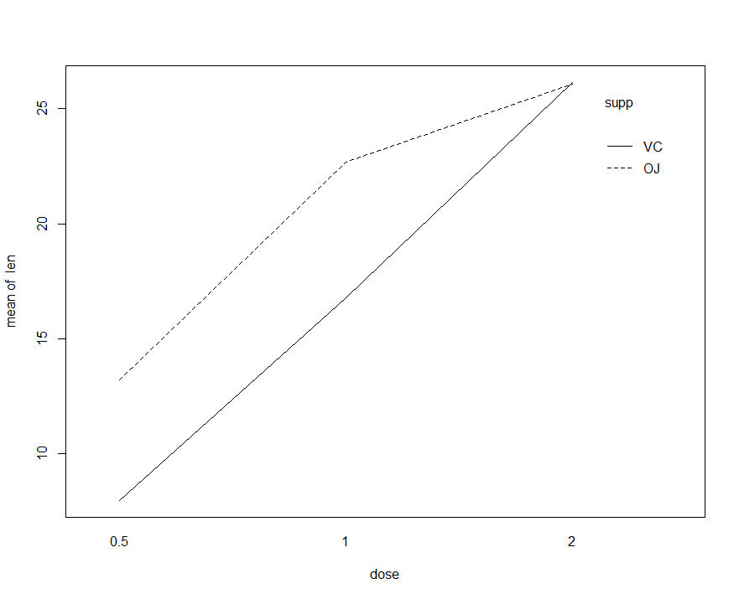
Formal Data Analysis
Interaction between supplement and dose significant
with(ToothGrowth, interaction.plot(dose, supp, len))
The data provide evidence for an interaction effect
> anova(anova.mod1,anova.mod2) # evidence for interaction
Analysis of Variance Table
Model 1: len ~ factor(supp) + factor(dose)
Model 2: len ~ factor(supp) * factor(dose)
Res.Df RSS Df Sum of Sq F Pr(>F)
1 56 820.43
2 54 712.11 2 108.32 4.107 0.02186 *
---
Signif. codes: 0 ‘***’ 0.001 ‘**’ 0.01 ‘*’ 0.05 ‘.’ 0.1 ‘ ’ 1

Slide 35
Formal Data Analysis
Logistic regression
Assumptions
Number of groups = 2+
Predict a binary variable
Normality of data
Data: numerical + categorical
RQ: Is there an effect of gender and age on the enjoyment probability over the new taste?
For more examples, check tutorial 7b or example exam
R code:
> summary(logistic.mod <- glm(enjoyed ~ gender + age, tastesgreat, family=binomial(logit=link)) # logit=link fits the model by using “log(enjoyed)”
Call:
glm(formula = enjoyed ~ gender + age, family = binomial, data = tastesgreat)
Deviance Residuals:
Min 1Q Median 3Q Max
-1.84192 -0.88512 -0.06624 0.74655 2.55961
Coefficients:
Estimate Std. Error z value Pr(>|z|)
(Intercept) -8.18443 3.09644 -2.643 0.00821 **
genderMale 2.42241 0.95590 2.534 0.01127 *
age 0.16491 0.06519 2.530 0.01142 *
---
Signif. codes: 0 ‘***’ 0.001 ‘**’ 0.01 ‘*’ 0.05 ‘.’ 0.1 ‘ ’ 1
(Dispersion parameter for binomial family taken to be 1)
Null deviance: 55.452 on 39 degrees of freedom
Residual deviance: 38.981 on 37 degrees of freedom
AIC: 44.981
Number of Fisher Scoring iterations: 5
gender and age are important predictors for enjoying the new taste
Holding the other variables constant, if the person is one year older, chances to enjoy the taste are $e^{0.164}=1.179$ times higher
Holding the other variables constant, the chances to enjoy the taste are $e^{2.422}=11.26$ times higher for males relative to females
If you don’t want to calculate this by hand, see next slide

Slide 36
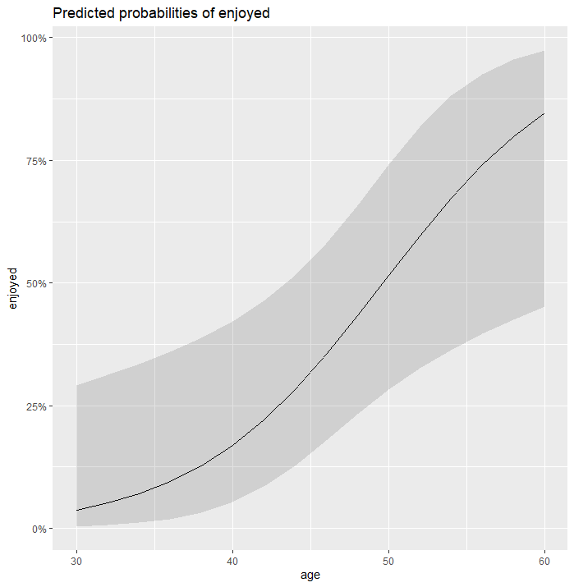
Formal Data Analysis
How to visualize the odds
R code:
> cbind(exp(summary(logistic.mod)$coef)[,1], exp(confint(logistic.mod)))
Waiting for profiling to be done...
2.5 % 97.5 %
(Intercept) 2.789622e-04 2.062818e-07 0.05426256
genderMale 1.127297e+01 2.073735e+00 98.63778546
age 1.179281e+00 1.053802e+00 1.37046974
With an increase in age by one year (one unit), the odds of enjoy increase by 18% or 0.18 ((1.179 - 1)/1 *100 = 17,98 ~ 18 ), basically the increase from 1 to 1.179 is by 0.18 = 18%
The odds of Males to have enjoyed are 11 times larger
BONUS: look at effect plots
> install.packages("sjPlot")
> library(sjPlot)
> plot_model(logistic.model, type="pred", terms = c("age"))
Probability to like the taste increases with age

Slide 37
Formal Data Analysis
Model selection
Step AIC
Calculates the AIC value for all models and chooses the model with the smallest value
If the best model includes “insignificant” predictors, don’t worry, you can make an observation about that
anova() for nested models
If the p-value for the second model < 0.05, at least one of the extra predictors is significant for the model
If the p-value for the second model > 0.05, all the extra predictors are not significant for the model
R code:
> stepAIC(model, trace=FALSE) # library(MASS)
# trace=FALSE only prints the best model
Call:
lm(formula = sales ~ youtube + facebook, data = marketing)
Coefficients:
(Intercept) youtube facebook
3.50532 0.04575 0.18799
> modelyfn <- lm(sales ~ youtube + facebook + newspaper, data = marketing)
> modelyf <- lm(sales ~ youtube + facebook, data = marketing)
> anova(modelyf, modelyfn)
Analysis of Variance Table
Model 1: sales ~ youtube + facebook
Model 2: sales ~ youtube + facebook + newspaper
Res.Df RSS Df Sum of Sq F Pr(>F)
1 197 801.96
2 196 801.83 1 0.12775 0.0312 0.8599
H0: B3(coefficient for newspaper) = 0
If you were to have more predictor variables in the second model:
H0: Bk+1 = Bk+2 = … = Bp = 0 ; k = # of predictors in the smaller model
p = last predictor
HA: Bi ≠ 0

Slide 38
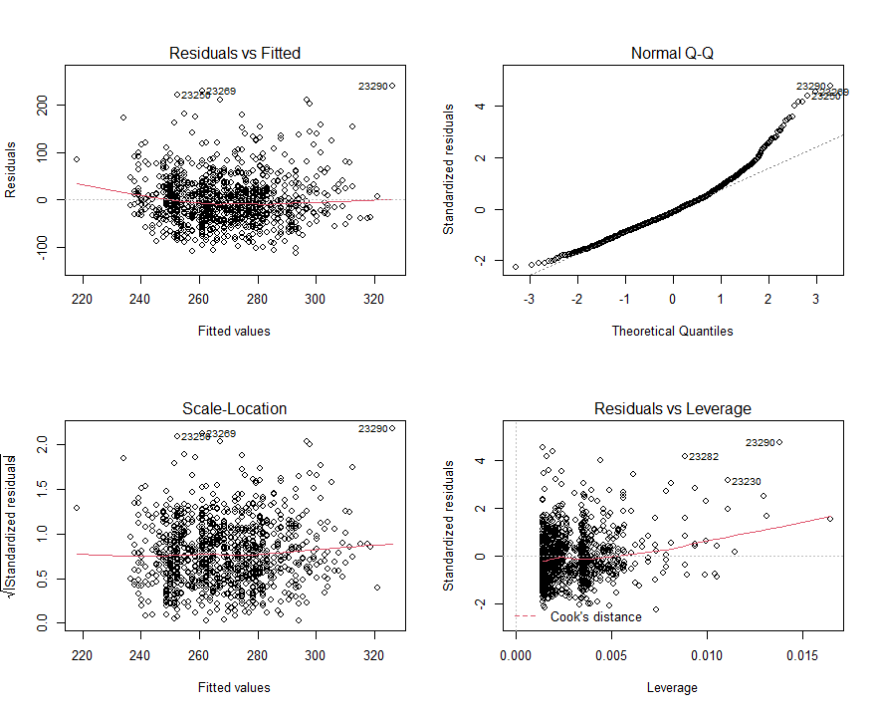
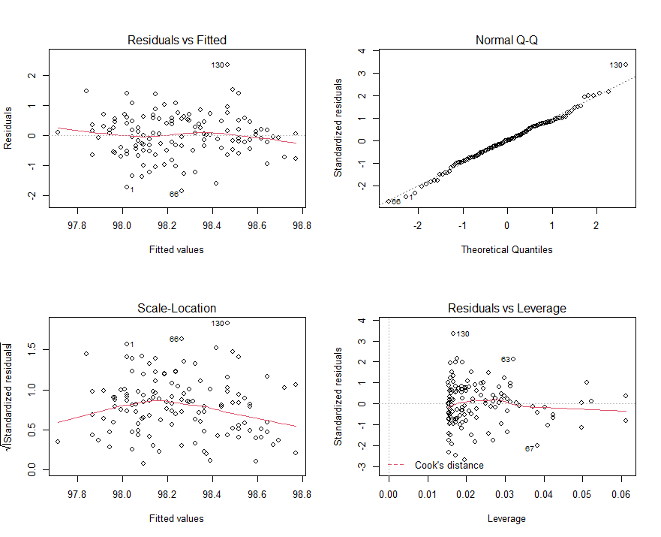
BONUS
> outlierTest(lm(time ~ age + factor(gender), data = nym.2002))
rstudent unadjusted p-value Bonferroni p
23290 4.807468 1.7641e-06 0.0017641
23269 4.568782 5.5204e-06 0.0055204
23250 4.415943 1.1156e-05 0.0111560
23282 4.200459 2.9025e-05 0.0290250
23255 4.171902 3.2842e-05 0.0328420
Check for significant outliers:
> outlierTest(lm(temperature ~ hr + factor(gender), normtemp))
No Studentized residuals with Bonferroni p < 0.05
Largest |rstudent|:
rstudent unadjusted p-value Bonferroni p
130 3.50005 0.0006438 0.083694
Point outside of Cook’s distance -> large leverage point
No outlying observations , only one large rstudent, after Bonferroni correction and the model diagnostics are fine
Some caution is in order due to outlying observations not passing the Bonferroni test because several rstudent values are too large after Bonferroni correction

Slide 39
GOOD LUCK!

